Slide 1

Urban Decay Cosmetics Supply Chain Optimization
Transforming challenges into strategic advantages through data-driven insights
By
Bukola Adesuji

Slide 2
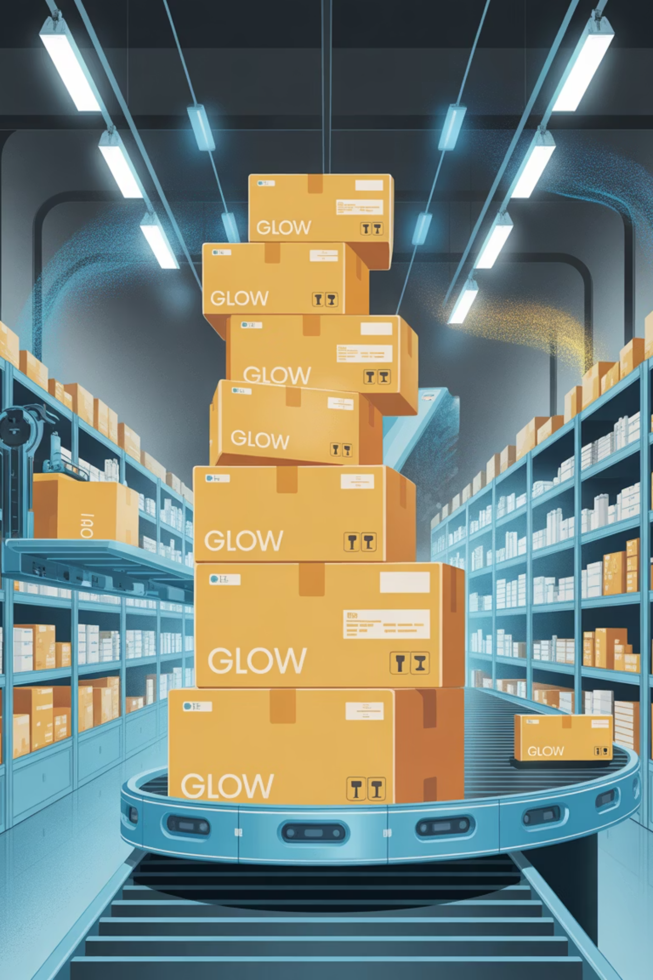
The Growth Challenge
Urban Decay's rapid expansion across U.S. markets has created unprecedented demand, but success has brought new complexities. While customers love the products, rising shipping costs, frequent stockouts, and delivery delays are threatening the brand's reputation.
Leadership recognized that their supply chain needed strategic attention to support sustainable growth and maintain customer satisfaction.

Slide 3
Critical Issues Identified
Stockout Risk
Supplier Dependency
Quality Concerns
High-demand SKUs showing low availability despite strong order volumes, creating lost sales opportunities
Over-reliance on Supplier 3 (63,000+ units) creates vulnerability to disruptions
Defect rates exceeding 200% threaten product integrity and customer trust

Slide 4
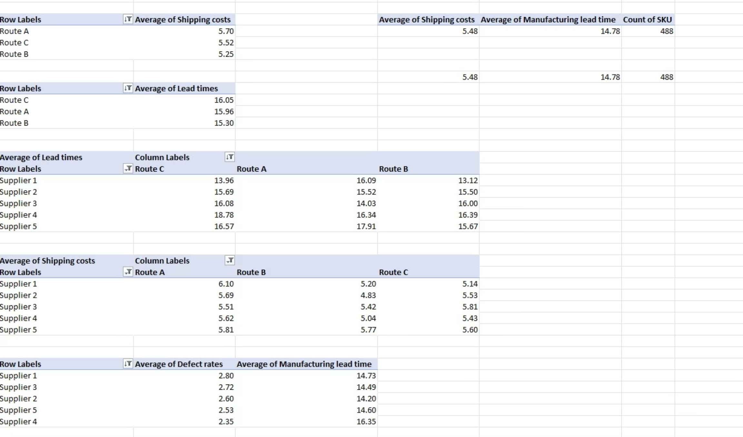
Urban Decay PivotTable

Slide 5
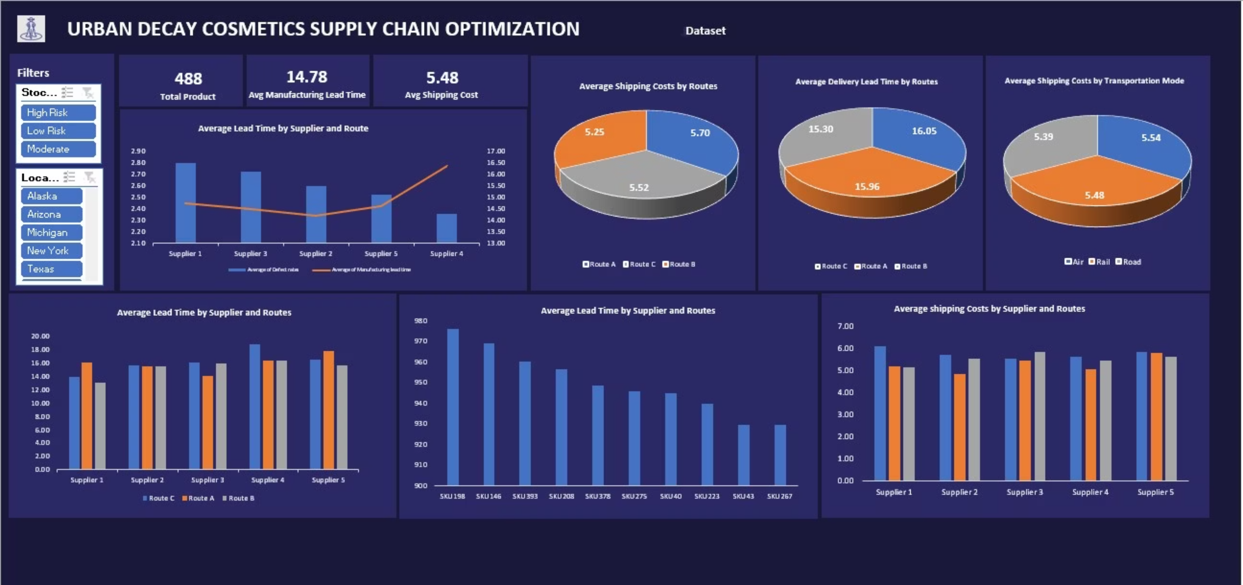
Dashboard For Insights and Visualization

Slide 6
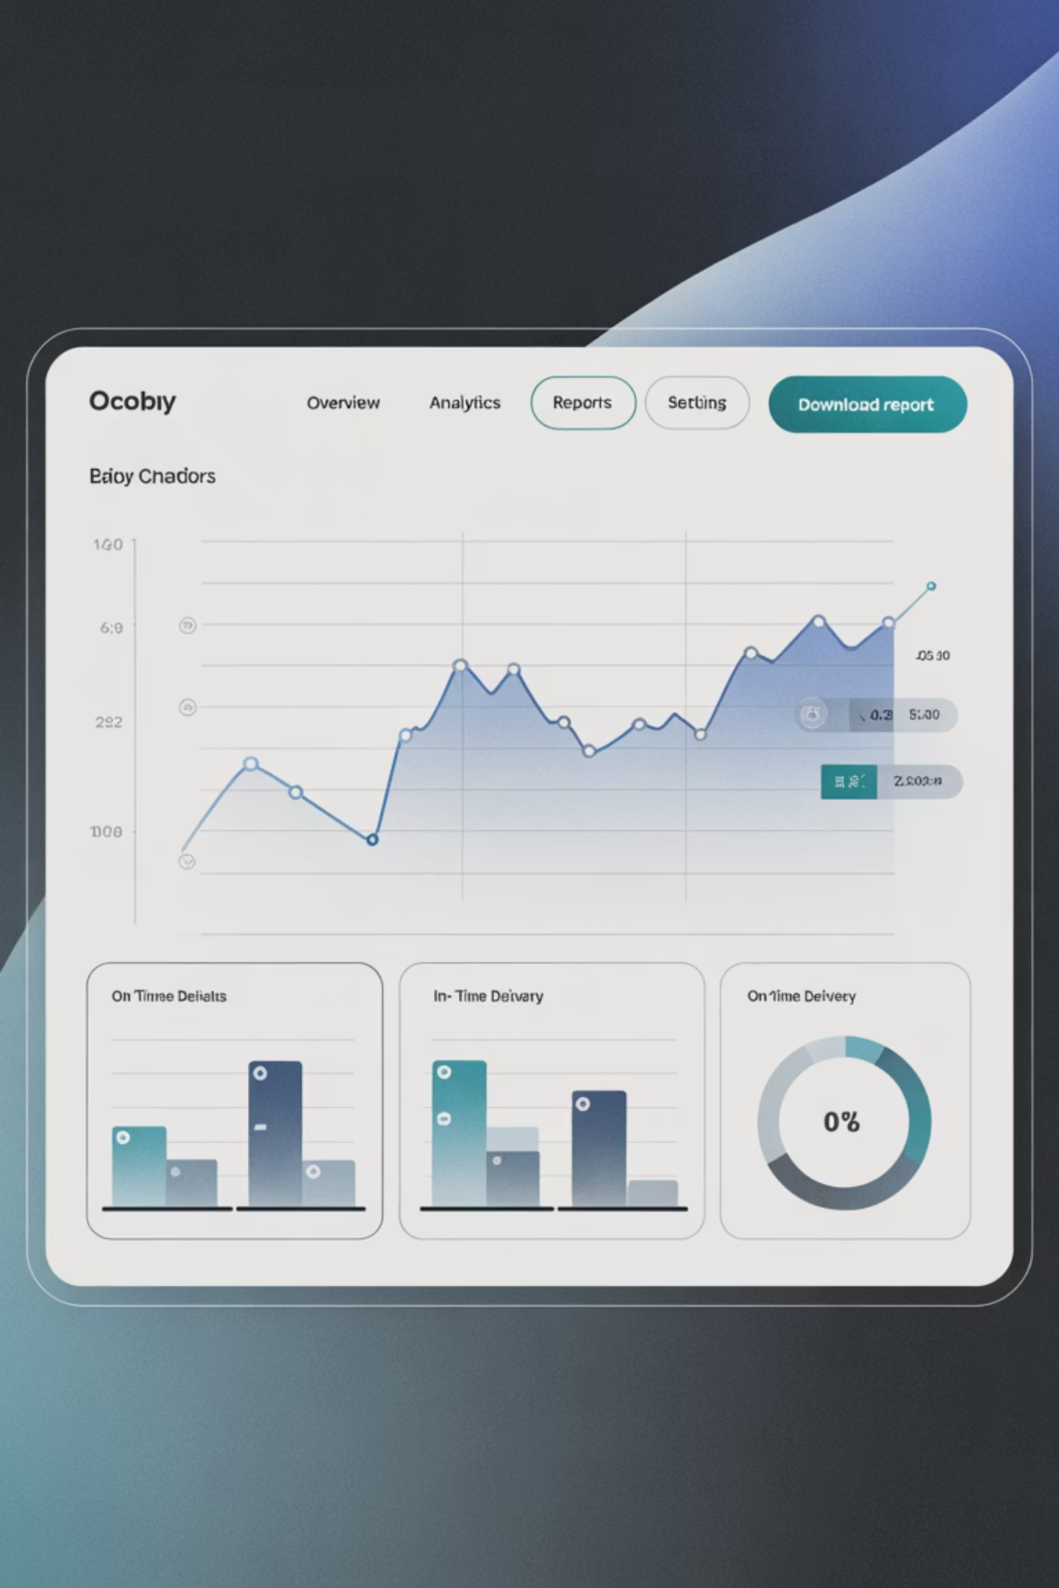
Operations Overview
488
14.8
$5.48
Total SKUs
Avg Lead Time
Avg Shipping Cost
Products analyzed across the entire portfolio
Days for manufacturing processes
Per unit across all routes and modes
$475
Avg Profitability
Per SKU with wide variation by product type

Slide 7
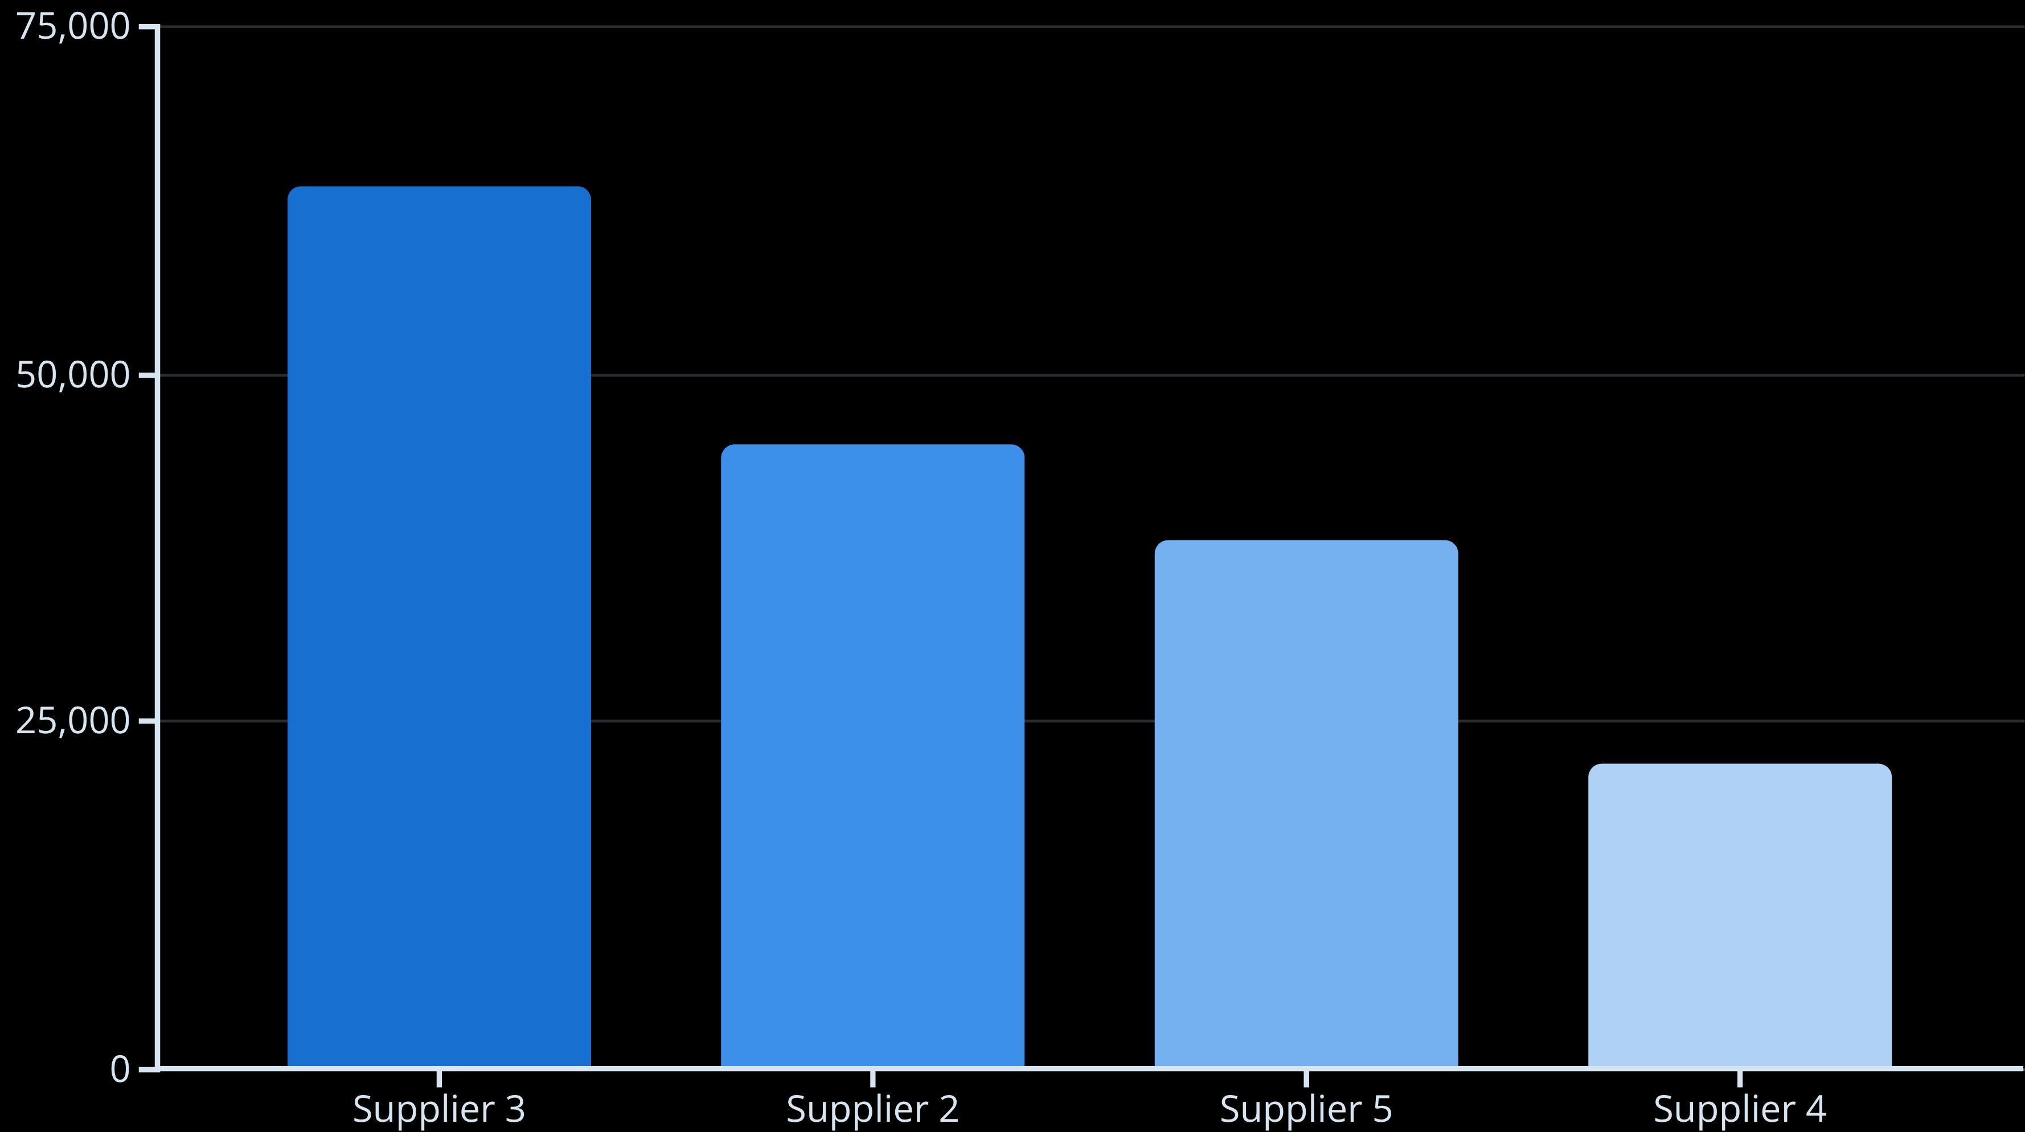
Supplier Performance Analysis
The data revealed significant imbalances in supplier relationships that create both opportunities and risks for Urban Decay's operations.
Heavy reliance on Supplier 3 creates a critical dependency risk, while Supplier 4's low volume and slower lead times indicate need for performance improvement or reassessment.

Slide 8



Shipping Route Trade-offs
Route A
Route B
Route C
Fastest: 15.3 days
Balanced: 15.9 days
Cheapest: $5.25 per unit
Cost: $5.70 per unit
Cost: $5.52 per unit
Speed: 16.1 days
Premium option for urgent shipments
Middle ground for standard orders
Cost-effective for bulk shipments
Clear cost-speed trade-offs require strategic allocation based on market priorities and product margins.

Slide 9
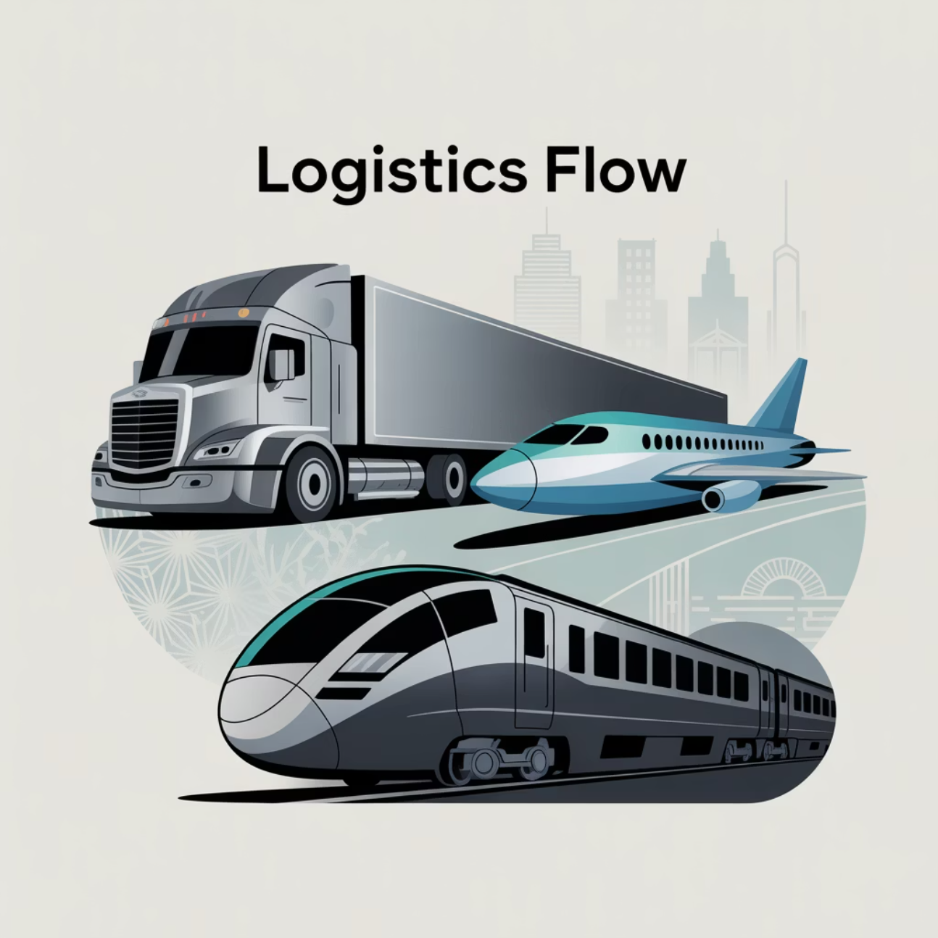
Transportation Mode Comparison
1
Air Transport
2
Road Transport
Cheapest option at $5.39 per unit, but may have capacity constraints for large volumes
Balanced middle option at $5.48 per unit with reliable capacity and flexibility
3
Rail Transport
Most expensive at $5.54 per unit, suitable for specific route requirements

Slide 10





Top Revenue Markets
Texas
$55.4K - Leading market performance
Alaska
$53.2K - Strong remote market presence
Washington
$50.7K - Consistent urban demand
Arizona
$47.2K - Growing southwestern market
Michigan
$44.8K - Solid midwest performance
Texas and Alaska represent critical growth markets requiring prioritized supply chain attention to protect revenue and brand reputation.

Slide 11
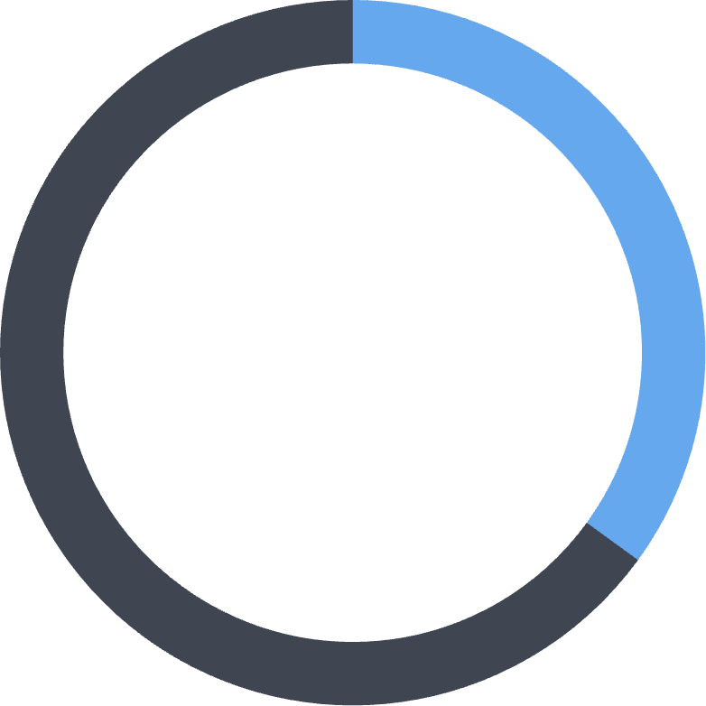
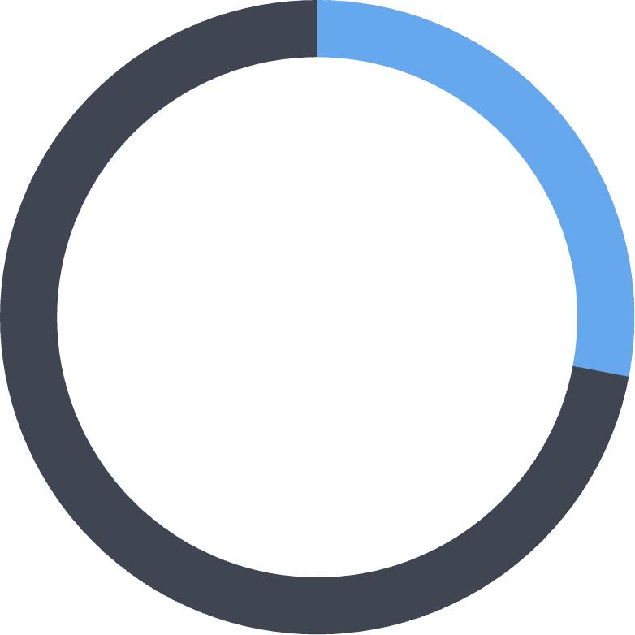
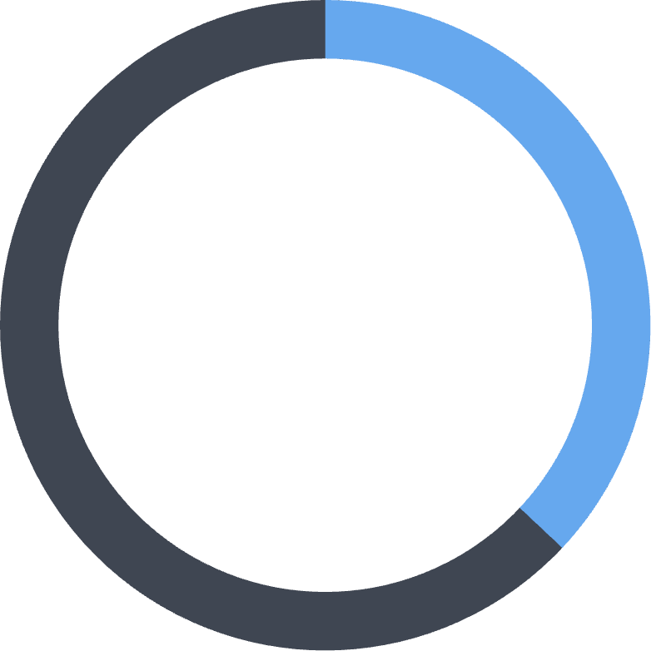
Stockout Risk Assessment
Several high-demand SKUs show dangerous inventory imbalances that threaten sales performance and customer satisfaction.
35%
28%
37%
High Risk SKUs
Moderate Risk
Low Risk
Products with critically low availability despite strong demand
Items requiring inventory buffer strategies
Well-balanced inventory levels

Slide 12



Strategic Recommendations
Optimize Route Usage
Diversify Suppliers
Strengthen Quality Control
Prioritize Route A for Texas & Alaska (highest revenue), use Route C for bulk shipments to balance cost and service
Reduce dependence on Supplier 3 by reallocating volumes to Suppliers 2 & 5, improve or replace Supplier 4
Validate defect rate metrics, implement standardized inspection reporting and supplier quality audits

Slide 13

Profitability-Driven Shipping Strategy
Premium SKUs
Standard SKUs
Route A (fastest delivery)
Route B (balanced option)
Air transport priority
Road transport efficiency
Texas & Alaska focus
Cost-optimized delivery
Enhanced quality checks
Bulk shipment strategies
Aligning shipping modes with product margins ensures optimal resource allocation while maintaining customer satisfaction across all market segments.

Slide 14

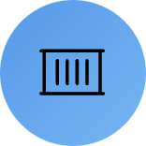




Risk Management & Scenario Planning
Supplier Disruption
Cost Fluctuations
Safety Stock
What-if modeling for Supplier 3 failure scenarios and contingency activation plans
Impact analysis of 10% freight cost increases across different transportation modes
Strategic inventory buffers for high-risk SKUs to cushion demand shocks

Slide 15
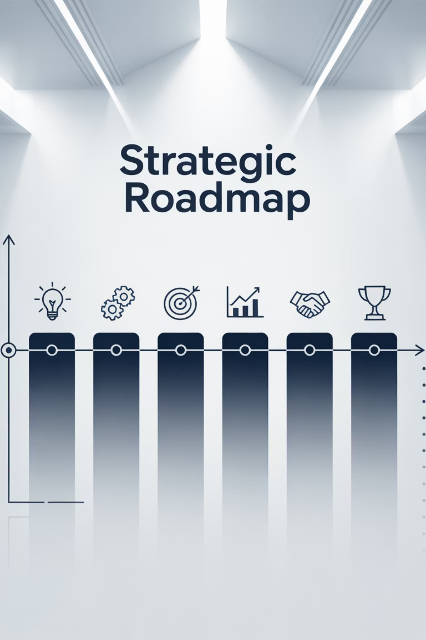
Implementation Roadmap
1
Phase 1: Immediate Actions
Validate defect rate data, implement Route A for Texas/Alaska, begin Supplier 4 performance review
2
Phase 2: Strategic Shifts
Rebalance supplier volumes, establish quality audit protocols, develop safety stock strategies
3
Phase 3: Optimization
Deploy predictive analytics, complete scenario planning models, establish continuous improvement processes

Slide 16




Expected Impact
Implementing these strategic changes will transform Urban Decay's supply chain from a cost center into a competitive advantage that drives sustainable growth.
Reduced Risk
Smarter Decisions
Diversified supplier base eliminates single points of failure and strengthens operational resilience
Data-driven shipping allocation protects revenue in top markets while optimizing costs elsewhere
Enhanced Quality
Scalable Growth
Improved quality control processes reinforce customer trust and brand reputation
Optimized supply chain becomes a strategic enabler for future expansion and market penetration

Slide 17

Strategic Success
Urban Decay's supply chain transformation represents more than operational efficiency; it is about building a foundation for sustainable growth, customer satisfaction, and market leadership in the competitive beauty industry.
By addressing supplier dependencies, optimizing shipping strategies, and implementing robust quality controls, Urban Decay positions itself to scale confidently while protecting profitability and brand reputation.

